Slide 1
What have we learned from 77 retrospectives?

Slide 2
Agenda
Introduction
Retrospective practice
Value of retrospectives
Challenges
External perspective
Improvements

Slide 3
We are a global classification, certification, technical assurance and advisory company
Notes:
We are a global certification, technical assurance and advisory company. Our reason for being goes back 150 years: to safeguard life, property and the environment and is the foundation for everything we do.

Slide 4
Global reach – local competence
150
years
400
offices
100
countries
16,000
employees

Slide 5






Organized to maximise customer value
MARITIME
OIL & GAS
ENERGY
BUSINESS ASSURANCE
SOFTWARE
CYBERNETICS
RESEARCH & INNOVATION

Slide 6

Next generation software solutions
Design and engineering
Process safety, risk and reliability
Commercial gas management
Ship management and operations
Asset integrity and performance
QHSE and enterprise risk
Ship and
offshore class
Electric grid reliability and performance
Asset simulation and optimization
Notes:
Design and Engineering:
Design and engineering of ships, offshore floaters, offshore fixed installations and subsea structures
Complete systems for strength assessment and sea-keeping analysis
Assessments according to offshore standards
Design and analysis of onshore and offshore wind turbine structures
Covers all engineering tasks during the lifetime of the asset, including simulation driven engineering in very early design
Strength assessment of rotating machinery components and propulsion systems
Software package for strength assessment of ship-structures.
A highly efficient environment for design and verification according to DNV GL class rules, also covering the Common Structural Rules
Process Safety Risk and Reliability
QRA - Industry standard method for carrying out Quantitative Risk Assessments of offshore and onshore process, chemical and petrochemical facilities.
The safety of an installation against any risk criteria can be assessed and guidance obtained concerning possible mitigation measures, such as changes in design, operation, response or land use planning.
RAM analysis software is a crucial tool in designing and analysing the performance of operations.
Designed to meet the needs of the Oil and Gas industry.
Allows you to model even the most complex process system and to see clearly what is required to improve its performance.
Allows you to safely and responsible analyse and improve production efficiency.
Asset Integrity and performance
Comprehensive solutions for
Fixed and floating offshore structures
Onshore and offshore pipelines
Onshore and offshore facilities
Supports the entire Plan-Do-Check-Act integrity cycle
Includes visibility of risk from CEO to inspection engineers
QHSE and Enterprise Risk
Improves risk and QHSE performance
Control and transparency of all deviations and actions
Communicates and structures vital company information
A comprehensive preventive and corrective action tracking system
Ship Management and Operations/Ship and Offshore Class
Supporting ship management, operations and business decisions
Includes technical management, hull integrity management, QHSE, dry docking, procurement and stock control, crewing, port clearance, voyage planning, weather routing and fleet performance monitoring.
Class production system, serving almost 14,000 vessels in DNV GL Class.
Electricity Grid Reliability and Performance
Extending the life of utility assets is now more important than ever. Growing cost of maintenance crews, high replacement equipment costs and long lead times must be balanced with reduced available manpower and increasing demands of the public and regulatory agencies for reliability. We gives utilities the ability to meet this challenge by focusing on utility Equipment Health.
Software solution for today’s utilities to meet the demands of equipment performance, reliability, and longevity
Quickly and easily determine how to maximize throughput for any transmission or distribution line
Asset Simulation and Optimization
Make informed decisions to minimise spend, mitigate risk and improve operational efficiency
Robust and accurate modelling and simulation of pipeline distribution network operations
Answering key questions about network capacity now and in the future
Maximizing efficiency of compressor stations

Slide 7

Product Line – QHSE and Enterprise risk
Improves risk and QHSE performance
Control and transparency of all deviations and actions
Communicates and structures vital company information
A comprehensive preventive and corrective action tracking system
Brand:
Synergi Life
Notes:
Key activities supported
Synergi Life manages all QHSE non-conformances, incidents, risk, risk analyses, audits, assessments and improvement suggestions.
Synergi Life software covers every workflow process, such as: Reporting, Processing , Analysing, Corrective actions, Communication, Experience transfer, Trending and KPI monitoring.
Value proposition
The Synergi Life Risk Management Module is designed to meet best practise risk management principles in accordance with ISO 31000, COSO, ISO 27000 etc.
Synergi Life software supports each stage in the risk management process on all levels of the organization.
Improving risk management at all levels within the business - from enterprise to occupational risk.
A number of practical methods are available to facilitate risk-based decisions. The choice of method depends on the objectives, scope and the entities involved.

Slide 8
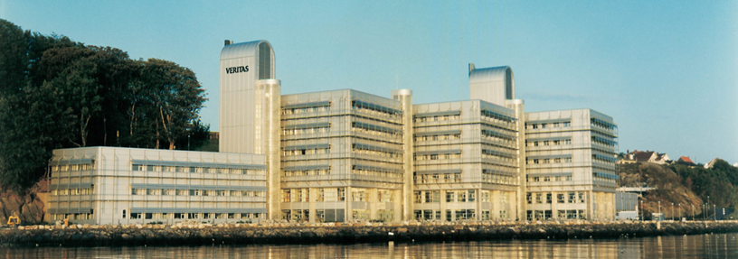
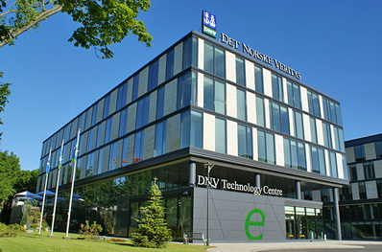
Teams in Stavanger – Poland (Gdynia)
Team in Stavanger - 12
Synergi Life Development since 1992
Team in Gdynia - 8
Synergi Life Development since 2012

Slide 9
Stavanger team
1 HoD – Product Owner
1 SCRUM Master
1 Architect
4 Developers
1 Content Responsible
2 Testers
1 Build and DB responsible
1 Third line support engineer

Slide 10
From scrum-way to our way
What we struggled with (using scrum)
Unable to complete agreed scope within sprint
Estimation
Waste
Resources not in use (i.e. testers in beginning of sprint)
Resources depleted (i.e. testers at the end of sprint)
Not satisfied with “flow”
The adaptions
No more sprints
Limiting work in progress, to improve flow
Time boxing (let’s see how far we get with this)
Reducing scope to reach deadline

Slide 11
Retrospective practice

Slide 12
Improvement and review cycle
3 weeks iterations = Improvement cycle
Demo meeting (review)
Iteration end
Show-off work done
Invite stake holders
Retrospective meeting
Let’s talk about it! (the process)
What was good?
What wasn’t all that good?
What can we do to improve the way we work?

Slide 13
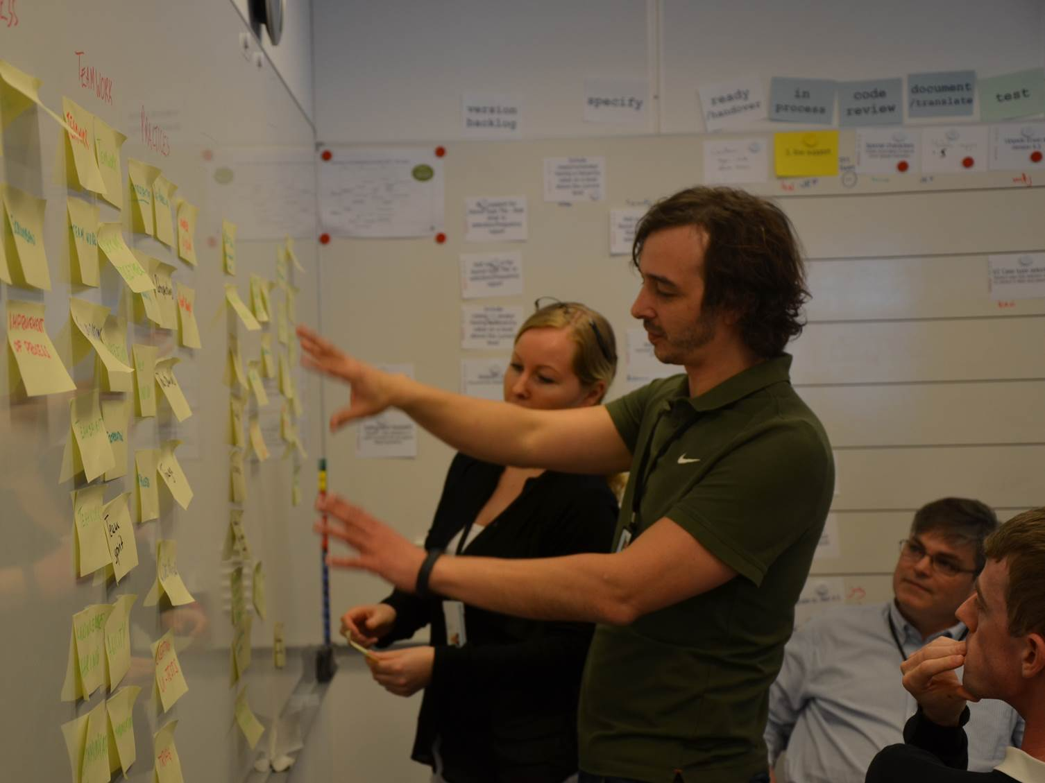
Retrospectives
Important to have at regular intervals
Things should be fresh in mind
Types of retrospectives
Iteration end
Hotfix
“Special” projects
Release
Recordings done in Synergi Life
Minutes of Meetings
Action tracking
Individual set as responsible for action

Slide 14
Value of retrospectives

Slide 15
Value of retrospectives
Promotes sharing and learning among team
Keeps the whole team engaged
Power to the team.
Changes to the process are influenced by the whole team
Actions are agreed upon by the whole team, after discussion
Ensures commitment for implementation
Keeps the quality process alive
ISO certified since 1996
Retrospectives encourages continuous improvement

Slide 16
Challenges

Slide 17
Challenges
Easy to have negative focus. Only focus on problems.
Personal relations is difficult to handle.
Feeling that we never achieve anything. Actions pile up!
Maintenance day introduced
Different level of contributions from team members.

Slide 18
External perspective

Slide 19
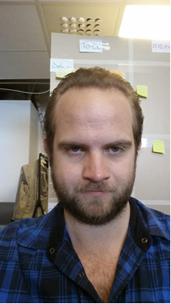
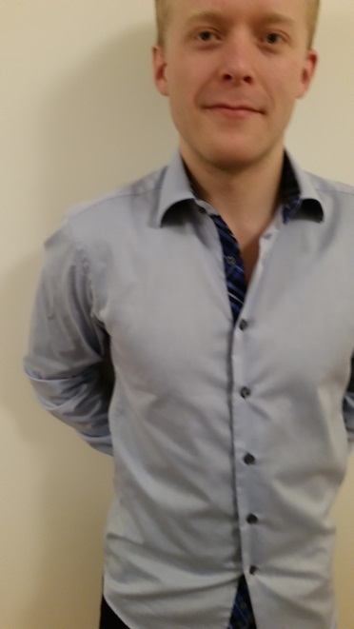
Master Thesis Spring 2015 – “Value of retrospectives”
Two NTNU students, Alf Magnus Stålesen & Bjørn Dølvik, have as part of their Master Thesis studied 77 of our retrospectives
17.08.2009 – 07.11.2014
Results have been presented for the team.
The team have had a retrospective on the findings.

Slide 20
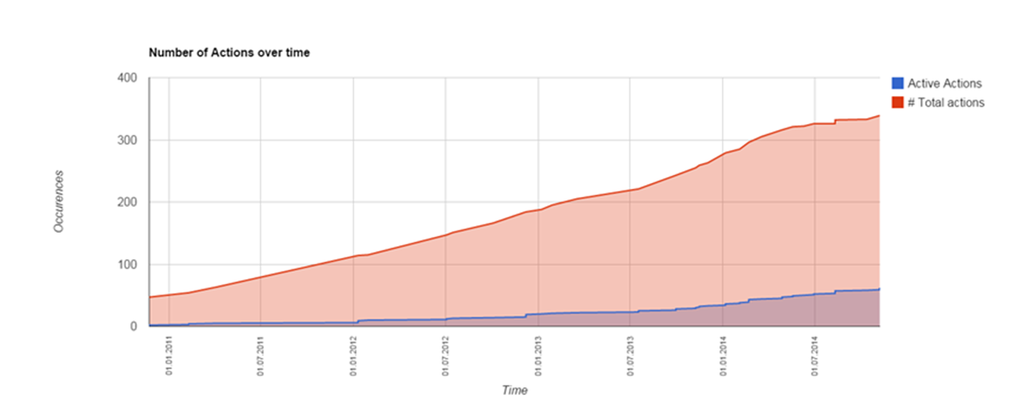
Analysis in general
77 retrospectives
343 actions
4,45 actions per retrospective
1,23 action per week
0,23 unsolved actions per week

Slide 21
Analysis - Nature
Positive
A continuation of functioning processes
Example
In general pair programming is a good way of both being more productive on hard problems, and also for passing on knowledge about the architecture and functionality in the program code. We should try to use pair programming more when possible.
Negative
Something that is not positive and where a problem is why action is created.
Example
When a developer sees/works on a bug that could be related to a current ongoing scenario he or she should at it to the title of the bug, and relate it to the scenario work item. If the bug is resolved before it's testable, a comment should be added to it to indicate that there is work in progress related to the fix of this bug.
This is to help the testers.

Slide 22
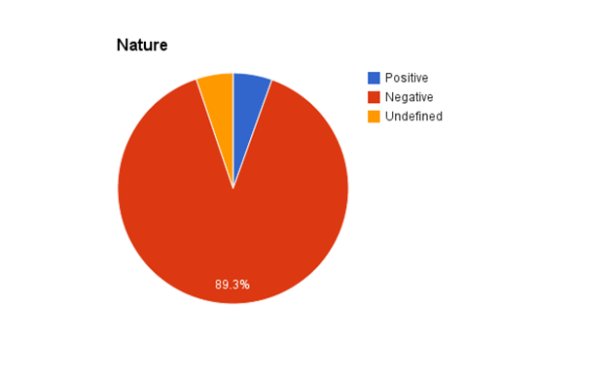
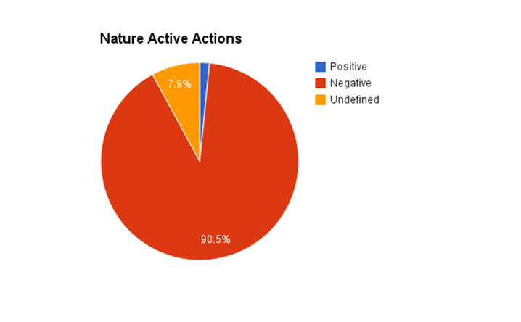
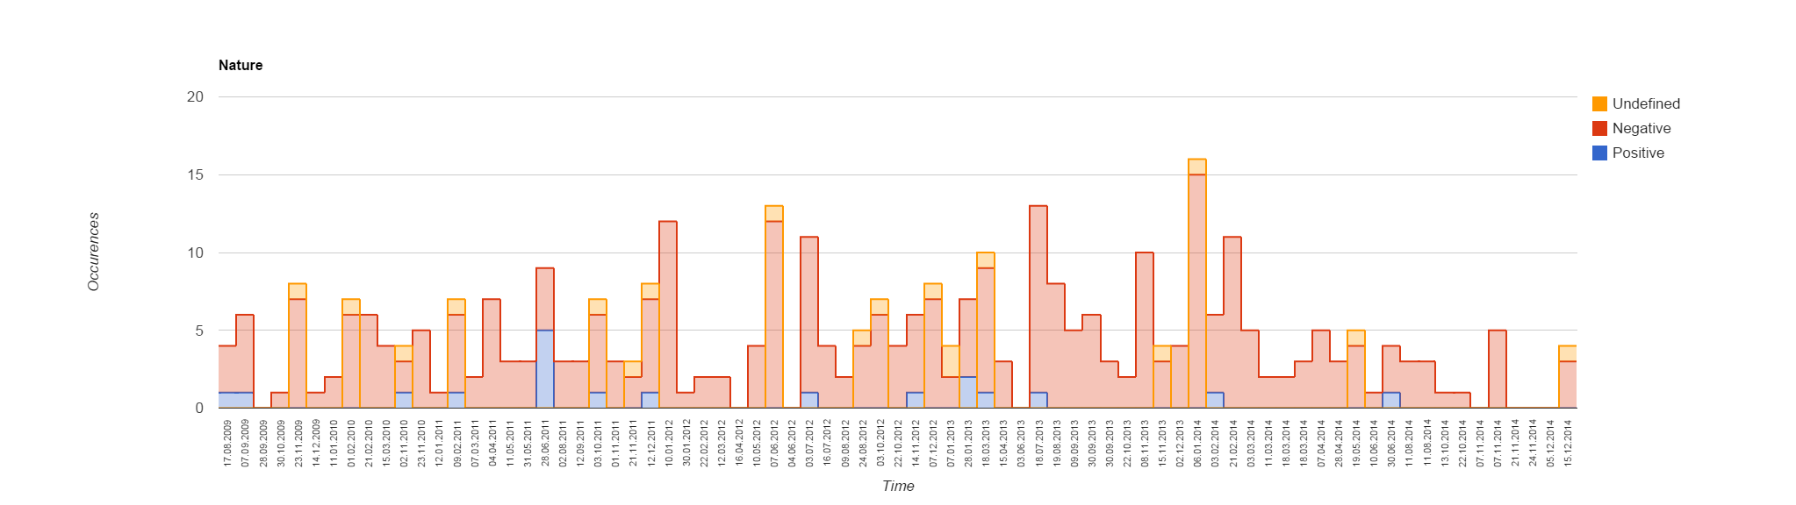
Analysis : Nature

Slide 23
Analysis : Organisational Learning
Single Loop:
An action changes the effect of the problem, but not the cause of the problem.
Do not fix the root cause
Typically quick fix
Example:
Create an overview of what builds are using what files. Look into the locking tools
Double loop
An action that address the root cause that the problem occurred and hinders future problems to occur.
Example:
Set up every second Thursday to be a day dedicated to fixing and testing general bugs (not related to scenarios)

Slide 24
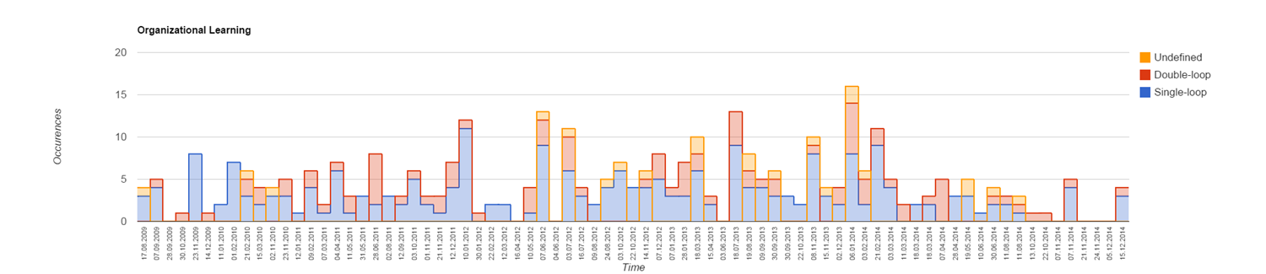
Analysis – Findings – Single loop / Double loop

Slide 25
Feedback from team retrospective on findings
Positive to have someone from the outside as they are felt more independent.
The team found many positive findings, building up on the value of retrospective.
The time spent on retrospectives gives value for money
Going forward we will adapt Synergi Life
New KPIs dashboard to focus on
Positive actions
Double loop (root cause) actions
Closed actions

Slide 26
Other improvements going forward

Slide 27
Improvements going forward
Continue with maintenance day to reduce open actions from retrospectives.
More joint retrospectives with Poland team.
Incorporate learning and techniques from today! ☺

Slide 28
Questions?
Jan.Edvard.Faugstad@dnvgl.com

